Slide 1
WEEK 7 ICT For Development (ICT4D) Socio-Economic linkages

Slide 2
What we intended to Discuss?
Let us pick up the thread
Multiple meanings, dimensions, approaches and perspectives of ‘Development’
Globalisation & Development
Technology and Development
ICT- Socio-economic Linkages
Outcomes of ICT- Socio-economic Linkages- Discussions

Slide 3
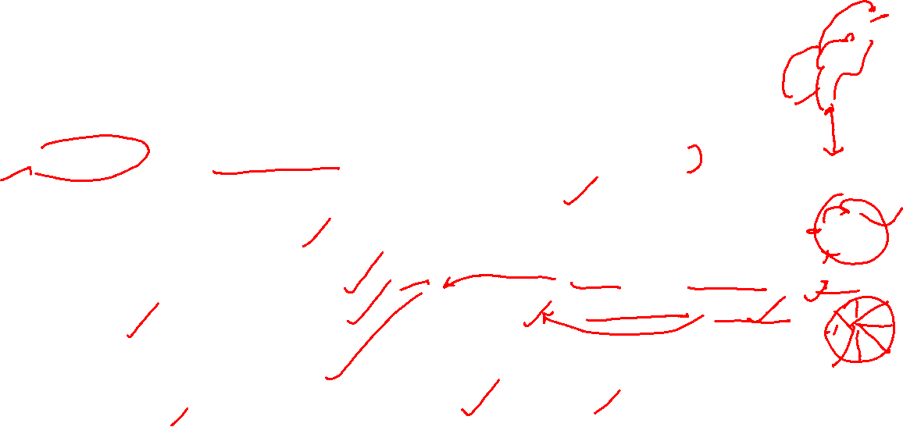
Let us pick up the thread- Development
Development is highly contested concept having wide ranges of meanings and connotations
In common parlance, it denotes a process of growth and progression towards betterment; a positive growth which is considered qualitatively good
It is a value judgemental concept, highly political and linked to power structure in society
Development as a discourse denotes various meanings getting assigned to the word development through narratives, speech, communication, language.
Dimensions of development- Economic, Social, Cultural, Political, Environmental, Human
Approaches to Development: Income Approach :Welfare, Rights Based, Capability, Sustainability
Human development: Increasing choices to have meaningful life: Health, Education, Resources
Alternate perspectives on Development: Marxian and Gandhian model

Slide 4
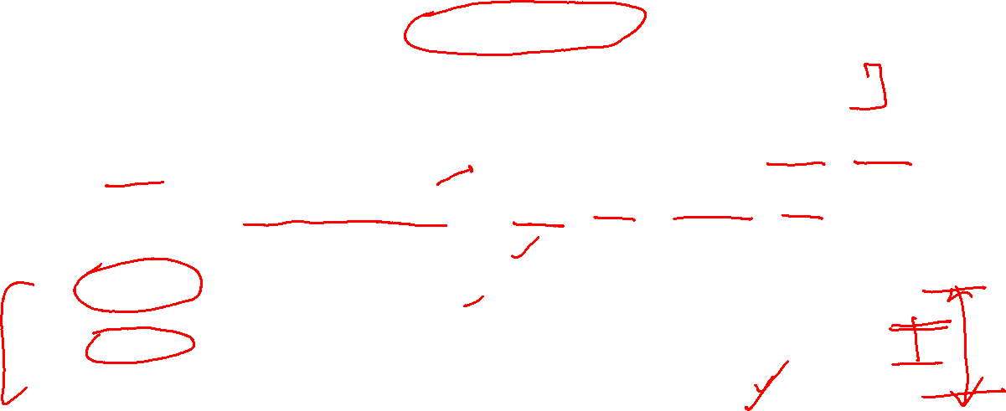
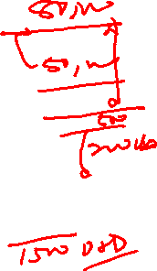
Let us pick up the thread- Globalisation
Globalization is greater and faster interconnectedness of people, places, information, objects, activities, and exchanges across the Globe
May denote process, condition, structure, force, Policy, marketing strategy, predicament, an age.
Deep impact on all aspects of people’s life, academic disciplines, science, research, and technology
Alternative perspectives on its existence, extent, origin, key drivers, nature and impacts.
It is multi-faceted and Multi-dimensional
For globalists it has brought economic prosperity, democracies, equality, peace, human rights, global governance
For escapists, on both side of political spectrum, it adversely impacted local people, created greater inequality, served interest of ‘Haves’ of ‘the North’, environmental destruction, consumerism, socio-cultural turmoil
Its relationship with Development is mixed and Indeterminate

Slide 5
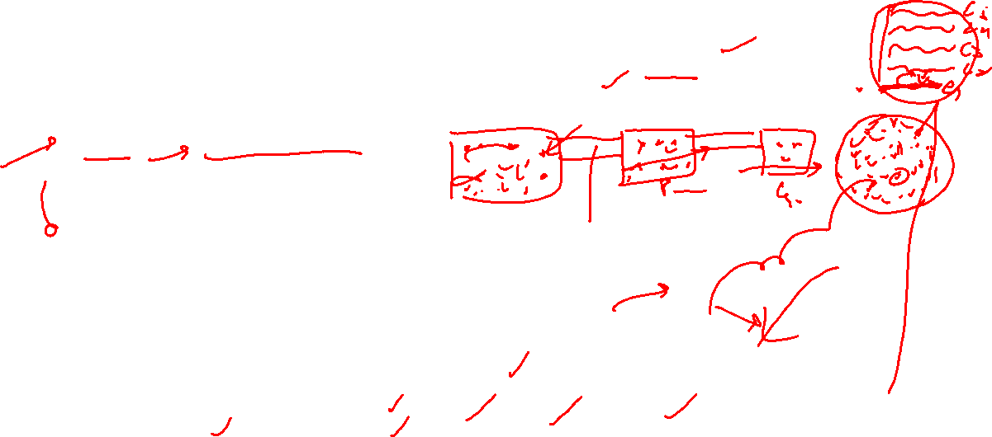
Technology and Development
The application of scientific knowledge for practical purposes, especially in industry, for creating product/services/process or any other specific purpose
Scientific & technological and Industrial Revolution in Europe made it rule the world for about 200 years.
Modern era social order deeply affected by Technology- Industrial Society, Capitalism, Liberal Democracy
Technology & Development
Closely Linked, re-produce each other
Technology projected as secular, scientific, value-neutral, a-political, universal
Hence, technology led development is secular, scientific, value-neutral, a- political, and universal
Technology played both way
widened the gap between technology have and have nots
Helped poor & marginalised to leap frog
Technology led development was not sustainable- environmental destruction, resource exhaustion, global warming, climate change
Socio-cultural impact- mass society, anomie, individualism, loss of social and cultural capital, cultural homogenisation, Hegemony

Slide 6
Technology and Development
Closely Linked, re-produce each other
Technology projected as secular, scientific, value-neutral, a-political, universal
Hence, technology led development is secular, scientific, value-neutral, a- political, and universal
Technology played both way
widened the gap between technology have and have nots
Helped poor & marginalised to leap frog and empowered
Technology led development was not sustainable- environmental destruction, resource exhaustion, global warming, climate change
Socio-cultural impact- mass society, anomie, individualism, loss of social and cultural capital, cultural homogenisation, Hegemony, conflicts & wars

Slide 7
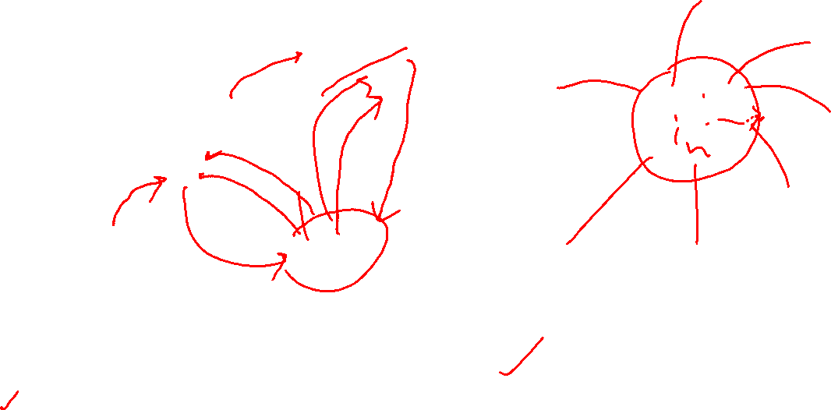
Development Globalization Technology- Seamless Web
Globalisation
Development
Technology
Globalization of American or western notion of development which is propelled by technology

Slide 8
Socio-economic Linkages
ICT4D

Slide 9
ICT: UNIQUE CAPABILITIES
Digital Empowerment
Technology Leap Frogging
Equalising power
lowers search and transaction costs
Improves the quality of information
Accelerates the diffusion of knowledge
Facilitate Innovation

Slide 10
ICT AND EDUCATION
E- learning
You tube, Edtech- Blackboard, Byju's, Dreambox Learning, Coursera, Knewton, Chegg
Online classes- Zoom, Google Meet, MS Team, etc.
MOOC- Massive Online Open Courses
SWAYAM-Study Webs of Active-Learning for Young Aspiring Minds
SWAYAM PRABHA- group of 34 DTH channels devoted to telecasting of high-quality educational programmes on 24X7 basis
Gyan Vani : educational FM radio station in several cities of India
NPTEL- National Programme on Technology Enhanced Learning
E-GYANKOSH ; NCERT books online; Shodhganga- open access to Research papers; INFLIBNET(Information and Library Network Centre)
ICT as most popular academic discipline
Pre-requisites: Digital Literacy, Access, Affordability

Slide 11
ICT AND HEALTH CARE
e-Healthcare
Online and remote medical consultation
e-Sanjeevani OPD- National Teleconsultation Service by Ministry of Health GOI
Practo
Online medicine supply
Tata1mg, Pharmeasy, Netmeds, Practo
Remote- Surgery
Diagnostic and preventive medical care
Online medical records
Ayushman Bharat Digital Mission
Life-saving assistance in connected Ambulances
Digital Literacy, Access, Affordability, physical infrastructure

Slide 12
ICT AND ECONOMIC OPPORTUNITY
digital economy-that part of economic output derived solely or primarily from digital technologies with a business model based on digital goods or services.
Online teaching
E-selling
E-commerce, M-Commerce, direct selling
BPO- call centre
ICT solutions- web designing, graphic designing, app development, networking solutions, hardware/software troubleshooting, etc.
ICT Degree/diploma- job opportunity
Cyber Café- multiple digital service delivery
Online advertisements
ICT Start-ups
Digital Skills, Access, Capital, entrepreneurial skills, physical infrastructure

Slide 13
ICT IN AGRICULTURE
Timely information and warnings
Weather Info, Viral & Locusts attacks, crop info, price and market info
E-selling
National Agriculture Market (eNAM) - a pan-India electronic trading portal
Drones
Farm survey, monitoring, diagnosis, applying pesticides/fertilizers
Production estimation
E-supply of inputs
E-loan, e-payments, e-crop insurance, e-soil testing
Disaster assessment and relief
Farmer’s portals
Digital Skills, Access, affordability, physical infrastructure

Slide 14
ICT and governance
Governance: the way collective decisions are taken and implanted in any society/nation ; It may involve multiple actors- Govt./state, private sector, NGOs/not for profit, MNCs, International organization, Civil Society, etc
E-Gov:
application of ICTs for delivering government services, exchange of information, transactions, integration of various stand-alone systems between government to citizen (G2C), government-to-business (G2B), government-to-government (G2G) as well as back-office processes and interactions within the entire government framework.
Use of ICT to support public services, government administration, democratic processes, and relationships among citizens, civil society, the private sector, and the state (Dawes , 2008)
Examples/initiatives:
e-office; passport seva; digital land records, e-courts, live broadcast of judicial & legislative process; open Govt; Cowin; Aadhar & DBT; ‘My Gov’ portal ; UMANG (Unified Mobile Application for New-age Governance) ; Govt e marketplace( GeM) launched ; digital village and e-Panchayat projects

Slide 15

Development of e-Gov in India
Department of Electronics was set up in 1970
National Informatics Centre (NIC) was set up in 1977
Big step towards e-Gov ;NIC was able to connect all District Hq to New Delhi through VSAT terminals
Counting for 1984 general Election- first big use of this connectivity
1987: NIC launched NICNET, electronically connecting Govt Agencies
Followed by DISNIC- district Information System
1984-89: Rajeev Gandhi gave a big push to computerization and use of ICT in governance
1990s-2000s: Digitalization of land records, and other govt records started ; State wide Area Network(SWAN); e-Gov in driving Licenses, land registration, and many other services. ; Launch of websites of Govt Agencies; Computerized public Grievance portal- CPGRAMS launched
2000: IT Act : Legal backing to digital signature, digital documents, email
2006: National e-Governance Plan(NeGP) launched ; 27 "Mission Mode Projects" (MMPs)
2008: Second Administrative Reforms Commission, titled "Promoting e-Governance - The Smart Way Forward“; launch of ‘common service centre (CSC)’
2009: National Unique Identification Project( Aadhar) launched
2011-12: NIC launched e-Office( paperless office in central govt ministries/agencies) ;
2014: My Gov portal was launched ; NeGD( National e-Governance Division) under Ministry of Electronics & IT launched several e-Gov Initiatives – UMANG (Unified Mobile Application for New-age Governance)
2015-19: Digital India mission Launched ; Direct Benefit Transfer Scheme Launched ; Govt e marketplace( GeM) launched ; digital village and e-Panchayat projects, Ministry of IT formed

Slide 16
Landmark e-Gov Initiates in India
G2C (Govt to Citizen)
Online Govt services: Online passport, Online Rly reservation, Online land registration, birth/death, Jeevan Pramaan, other certificates- Digi Locker, online banking/financial services, online driving and other licenses
My Gov portal ; Aadhar; Direct Benefit transfer( DBT)- cash transfer, scholarships, pensions, etc
E-filing of Income Tax returns, GSTN, FasTAG
Cyber Act 2000 & 2008: legal backing to digital Signature, emails, online documents
UPI (Universal payment Interface), Mobile Wallet, digital payments & transactions
G2B (Govt to Business)
e-Tendering, e-Auctioning, e-payment
MCA-21 portal
e-filing of Tax returns (GST & corporate tax)
G2G (Govt to Govt) and Govt-to-employees (G2E)
e-Office , Biometric Enabled attendance system
GeM –Govt e Marketplace
Public Finance Management System(PFMS)
Online performance appraisal system, online clearance and no objection certificates

Slide 17
ICT AND PANDEMIC
Personalized information
Arogya Setu App
Monitoring movements of infected persons
Through big data analytics and mobile tracing system
Work from home
Online working from home
Education from home
Online classes
Vaccination
COWIN App
Tele-medicine, online consultancy
Cashless payments- UPI, online shopping
Online entertainment, social networking, online family bonding
Digital Skills, Access, affordability, physical infrastructure

Slide 18
ICT and other socio-economic Linkages
ICT for sustainable Development
ICT for financial inclusion
UPI-Universal Payment Interface; online banking
ICT for smart Logistic support
PM Gati Shakti
ICT for Smart Cities
ICT for smart Planning
ICT in Sports, Arts/craft ( NFT)
ICT for Digital Empowerment

Slide 19

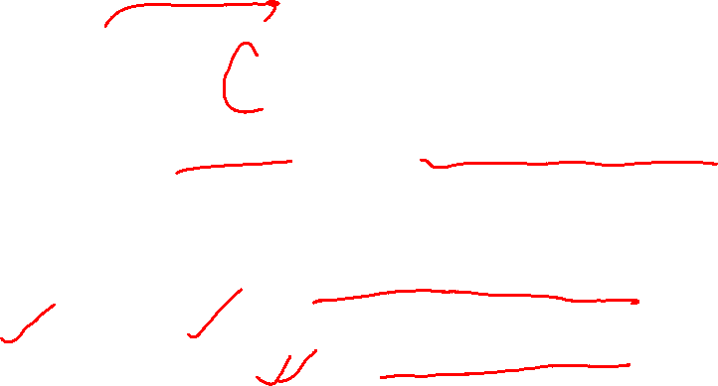
IT4SDG

Slide 20


Slide 21
UN SDG – SUSTAINABLE DEVELOPMENT GOALS
Social SDG 1 - No Poverty SDG 2 - Zero Hunger SDG 3 - Good Health and Well-Being SDG 4 - Quality Education SDG 5 - Gender Equality SDG 6 - Clean Water and Sanitation | Environmental SDG 12-Sustainable Consumption and Production SDG 13- Climate Action SDG 14- Life Below Water SDG 15- Life on Land
Economic SDG 7- Affordable and Clean Energy SDG 8- Decent Work and Economic Growth SDG 9- Industry, Innovation and Infrastructure SDG 10 – Reduced Inequalities SDG 11- Sustainable Cities and Communities | Fostering Peace and Partnership SDG16- Peace, Justice and Strong Institutions SDG 17- Partnerships for the Goals

Slide 22
SDG | Slogan | Mission Statement | Addl. Info
SDG1 | No Poverty | End poverty in all its forms everywhere Leave No One Behind- commitment to leave no one behind and to reach those farthest behind first | 10% below poverty line
2 | zero hunger | End hunger, achieve food security and improved nutrition, and promote sustainable agriculture | 10% of world population
3 | Good Health and Well-being | Ensure healthy lives and promote well-being for all at all ages | achieve universal health coverage
4 | quality education | Ensure inclusive and equitable quality education and promote lifelong learning opportunities for all | Literacy Rate- India-74% World- 87%
5 | gender equality | Achieve gender equality and empower all women and girls
6 | clean water and sanitation | Ensure availability and sustainable management of water and sanitation for all | ‘Jal Jeevan Mission’-GOI
7 | Affordable and Clean Energy | Ensure access to affordable, reliable, sustainable and modern energy for all
8 | decent work and economic growth | Promote sustained, inclusive and sustainable economic growth, full and productive employment and decent work for all
9 | industry, innovation and infrastructure | Build resilient infrastructure, promote inclusive and sustainable industrialization, and foster innovation | universal access to ICTs.

Slide 23
SDG | Slogan | Mission Statement | Addl. Info | Addl. Info
10 | reduced inequality | Reduce inequality within and among countries | Gini coefficient 10% of the global population currently take home 52% of the income The poorest half -8 % of income | Gini coefficient 10% of the global population currently take home 52% of the income The poorest half -8 % of income
11 | sustainable cities and communities | Make cities and human settlements inclusive, safe, resilient, and sustainable
12 | responsible consumption and production | Ensure sustainable consumption and production patterns |  | LiFE-Lifestyle for the Environment
13 | climate action | Take urgent action to combat climate change and its impacts by regulating emissions and promoting developments in renewable energy
14 | Life below water | Conserve and sustainably use the oceans, seas and marine resources for sustainable development
15 | Life on land | Protect, restore and promote sustainable use of terrestrial ecosystems, sustainably manage forests, combat desertification, and halt and reverse land degradation and halt biodiversity loss"
16 | peace, justice and strong institutions. | Promote peaceful and inclusive societies for sustainable development, provide access to justice for all and build effective, accountable and inclusive institutions at all levels
17 | partnerships for the goals | Strengthen the means of implementation and revitalize the global partnership for sustainable development |  | Collective Action Dilemma

Slide 24
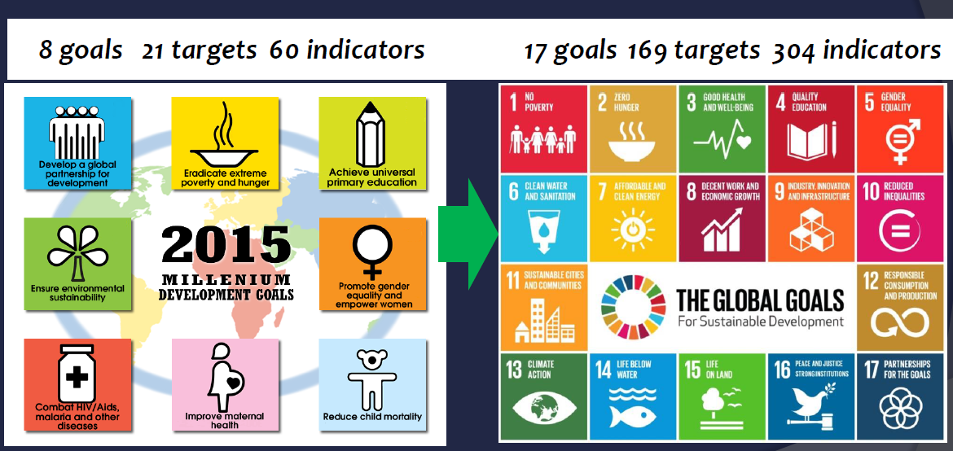
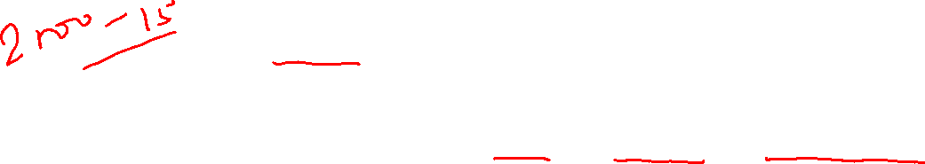
MDGs Vs. SDGs

Slide 25

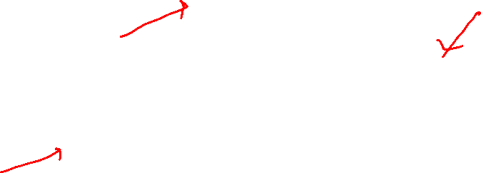
Role of ICT in SDGs
ICTs are catalytic drivers to enable the achievement of all the SDGs
“ The spread of information and communication technology and global interconnectedness has great potential to accelerate human progress, to bridge the digital divide and to develop knowledge societies, as does scientific and technological innovation across areas as diverse as medicine and energy”.
Agenda for Sustainable Development (Paragraph 15)
Read this ITU document on ICT and SDG ( ICT4SDG)
https://unctad.org/system/files/non-official-document/cstd2016_p06_DoreenBogdan_ITU_en.pdf

Slide 26
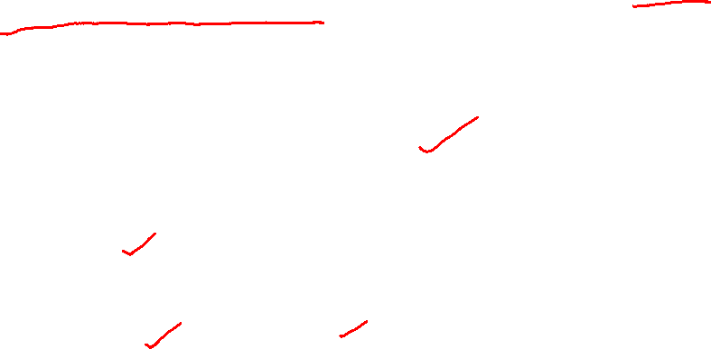
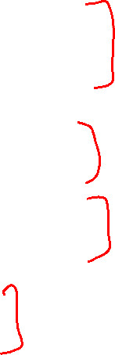
SDGs and ICT
While none of the SDGs is specifically about ICTs, several targets make references to ICTs and technology
The spread of information and communications technology and global interconnectedness has great potential to accelerate human progress, to bridge the digital divide and to develop knowledge societies.
ICT mentioned in SDG
Significantly increase access to information and communications technology and strive to provide universal and affordable access to the Internet in least developed countries by 2020
Fully operationalize the technology bank and science, technology and innovation capacity-building mechanism for least developed countries by 2017 and enhance the use of enabling technology, in particular information and communications technology
Enhance the use of enabling technology, in particular information and communications technology, to promote the empowerment of women

Slide 27
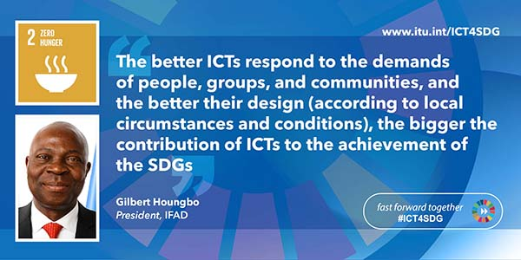

Fast Forward Together: ICT4SDG

Slide 28


Slide 29
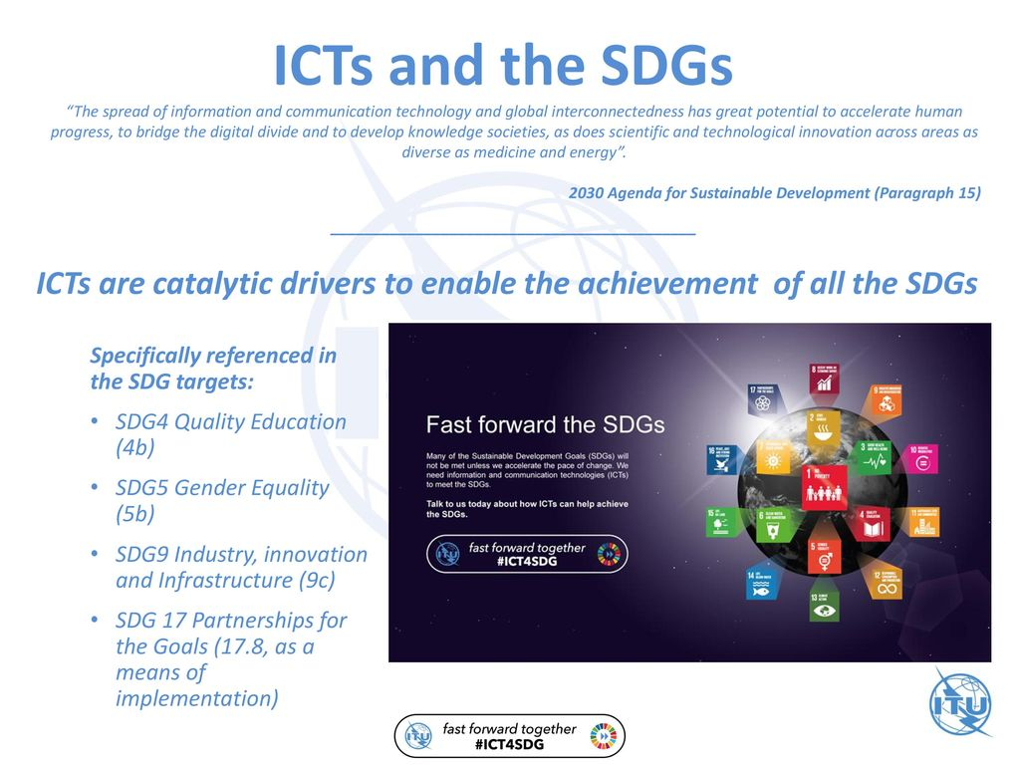



Slide 30
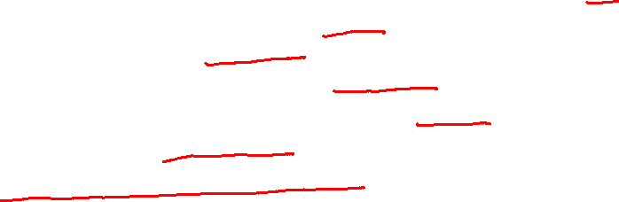
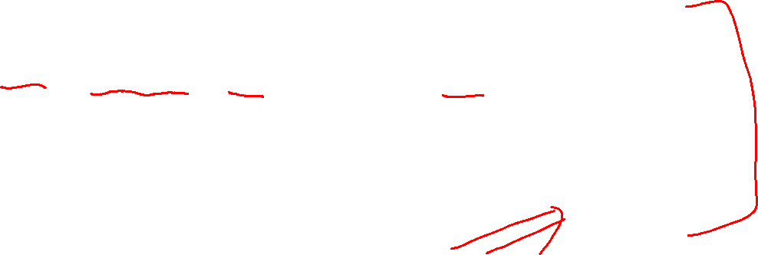
SDG and ICT
<Proposed SDG indicators related to ICTs>
Target 4a: Proportion of schools with access to the Internet for pedagogical purposes (UIS)
Target 4a: Proportion of schools with access to computers for pedagogical purposes (UIS)
Target 4.4: Proportion of youth/adults with ICT skills, by type of skills (ITU)
Target 5b: Proportion of individuals who own a mobile telephone, by sex (ITU)
Target 9c: Percentage of the population covered by a mobile network, broken down by technology (ITU)
Target 17.6: Fixed Internet broadband subscriptions, broken down by speed (ITU)
Target 17.8: Proportion of individuals using the Internet (ITU)

Slide 31
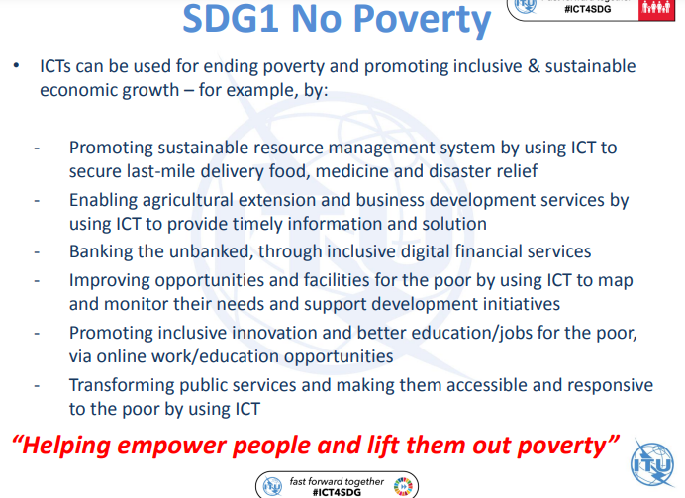


Slide 32
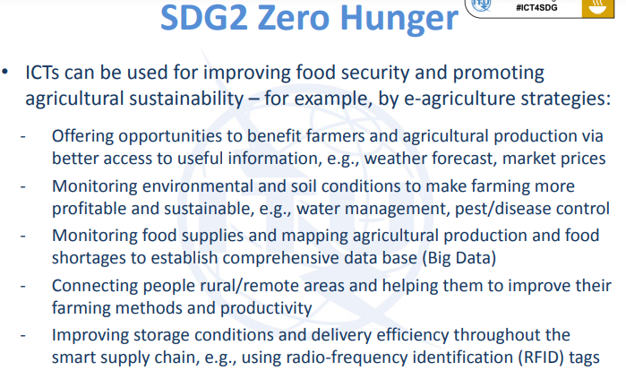

Slide 33
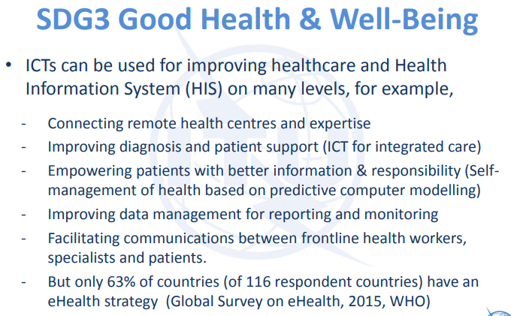

Slide 34
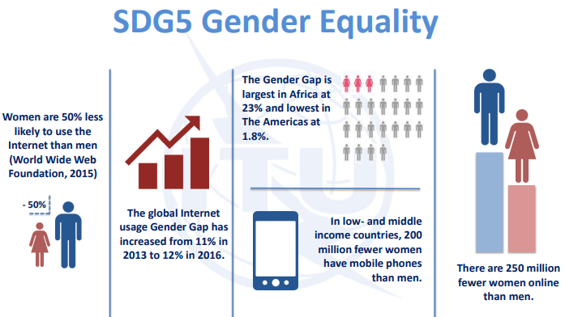
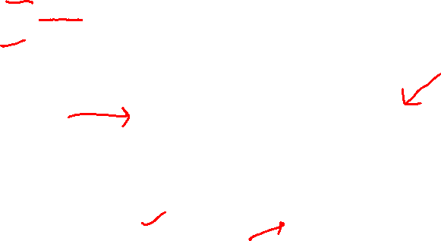

Slide 35
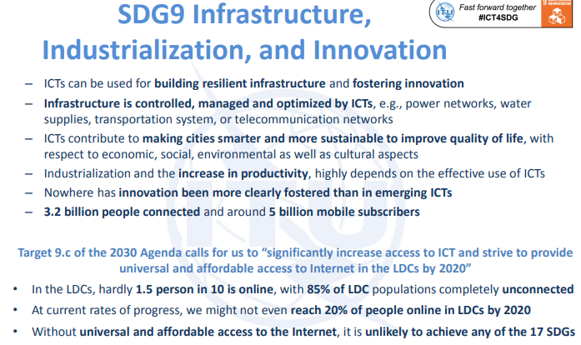

Slide 36
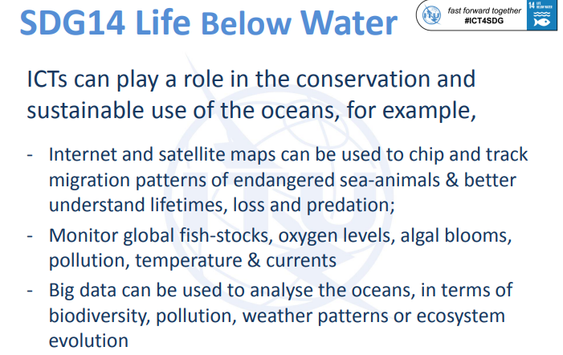


Slide 37
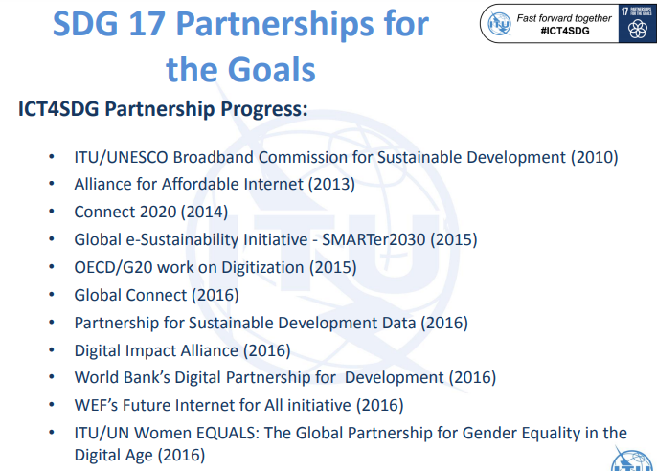


Slide 38
ICT4D: challenges Case Study: One Laptop per Child (OLPC)
OLPC-was a non-profit organisation by a MIT professor, in 2005, backed by UNDP
$ 100 laptop to each elementary school child in developing country
It failed…why?
Poor Govts needed to by millions of laptop( billions of USD)
Distribution issue- only to school enrolled students
Not customized to local language, content
Not linked to physical infrastructure and learning ecosystem in rural/remote schools

Slide 39
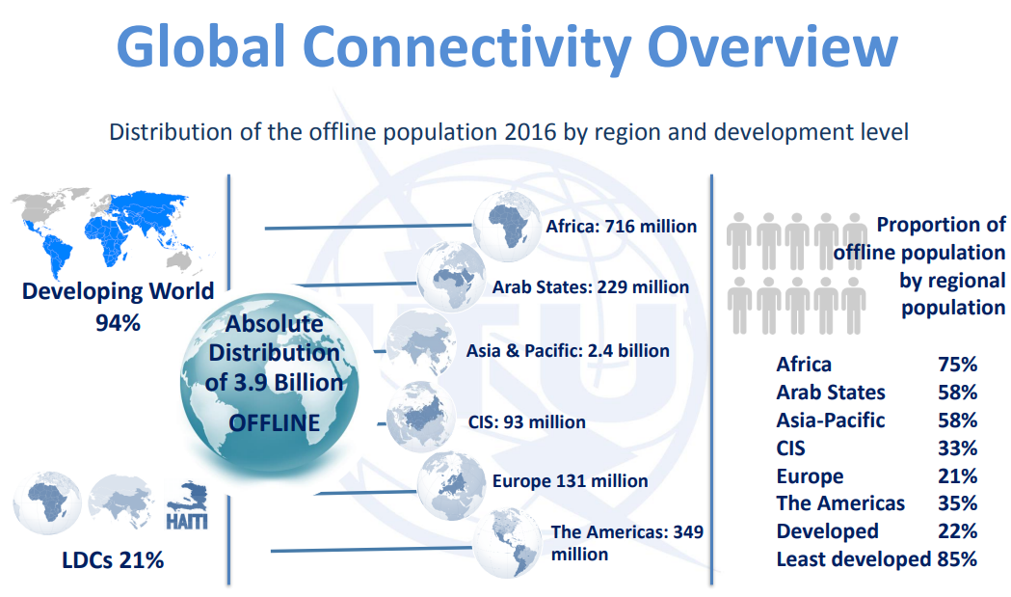

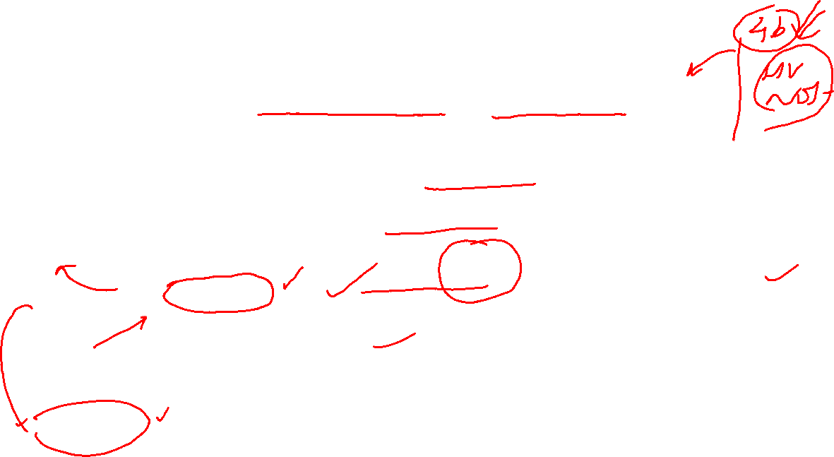

Slide 40
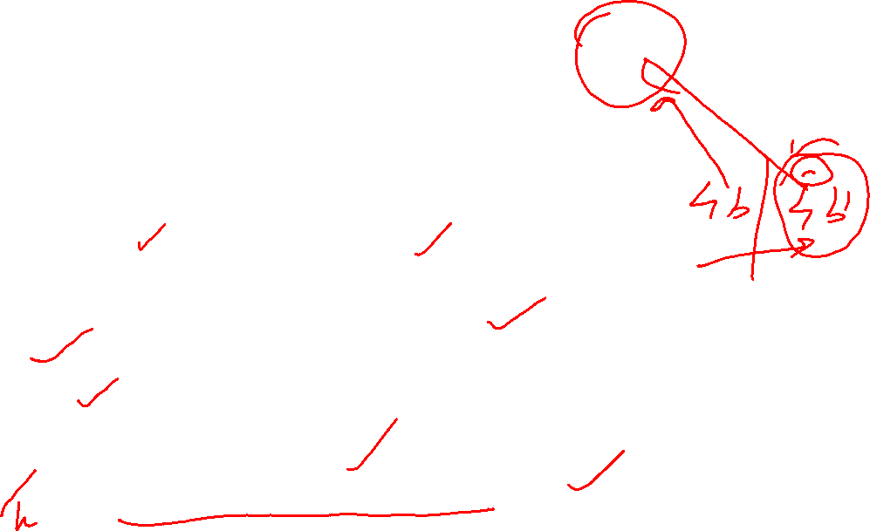
Discussion: ICT4D
Yes ICT may help faster ‘development’
But which ‘development’? For whom ‘development’? How that ‘development’ is brought about?
Who is producing ICT ? Who is using ICT?
Technological and Industrial revolution made Europe rule the world
Is ICT revolution is making USA rule the world?
ICT led ‘development’- then what about who are other side of digital divide?
More ICT development- more digital divide- more inequality?
How to made ‘the left outs’ capable of using ICT?

Slide 41
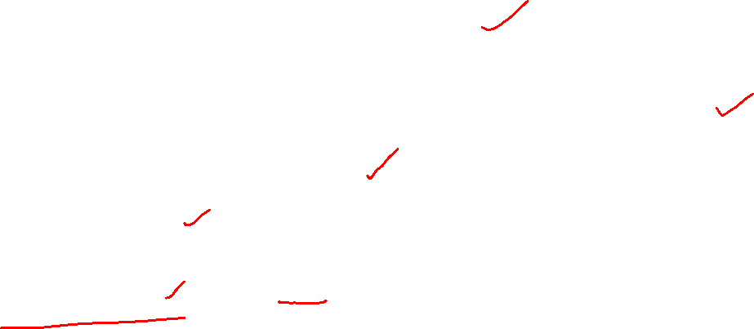
Let Us Sum Up
Development has multiple meanings, dimensions, approaches, and perspectives
Present discourse of Development is technology centric; it has affected all aspects of socio-economic arrangements
ICT is the most potent technology driving development in globalised world
ICT affects all socio-economic aspects in all parts of world
Outcomes of linkages of ICTs and socio-economic aspects are mostly positive but it may be negative for those who lack digital literacy/skill, access, affordability, and supporting physical infrastructure
Like any technology tool, ICT may even increase inequality, injustice, deprivation, and social cohesion
Hence, substantial challenge face political leadership and policy makers in developing countries to balance harness the potential of ICTs and mitigate its negative consequences

Slide 42
THANKS FOR LISTENING!
BE SAFE …GOOD WISHES !

